Slide 1


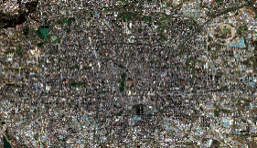

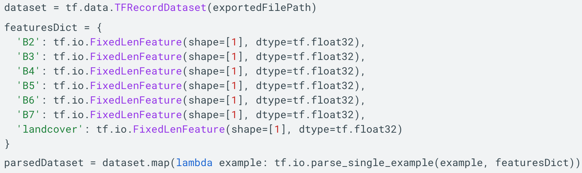
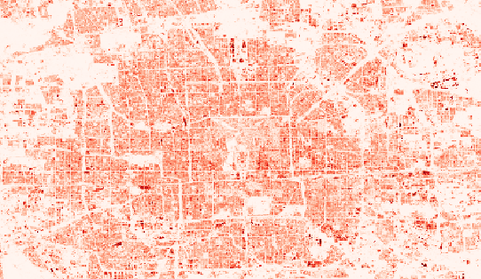
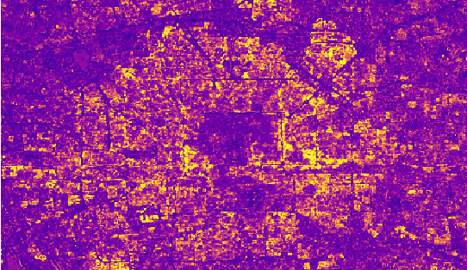
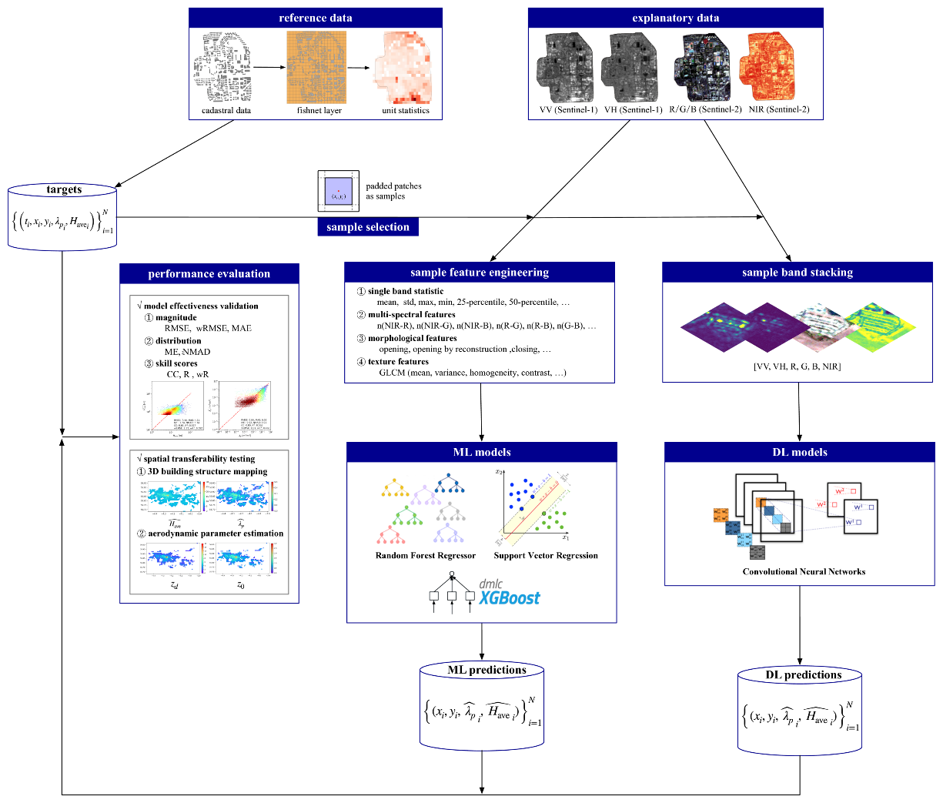
Sentinel Imagery on Google Earth Engine
TFrecords on Google AI Platform
1.1 Data export
ee.batch.Export.table.
toCloudStorage
(fileFormat=“TFRecord”)
Sentinel-1-VV
Sentinel-1-VH
Sentinel-2-RGB
Sentinel-2-NIR
2.2 Model Loading
ee.Model.fromAiPlatformPredictor
inputOverlapSize
proj, fixInputProj
outputBands
projectName
modelName
version
inputTileSize
Multiple Input
Multiple Output
?
Predicted results on Google Earth Engine
2.3 Prediction
ee.Model.predictImage(ee.Image)
GEE
AI Platform
2.1 EEification
earthengine model prepare
Input name
Output name
Input array
Output band
average building footprint
average building height
ML models on Google AI Platform
1.2 Training
tensorflow.keras.Model.fit()
Convolutional Neural
Networks (CNN)
Random Forest
eXtreme Gradient Boosting
Prediction with pretrained CNN models from SHAFTS on Google Cloud Infrastructures

Slide 2
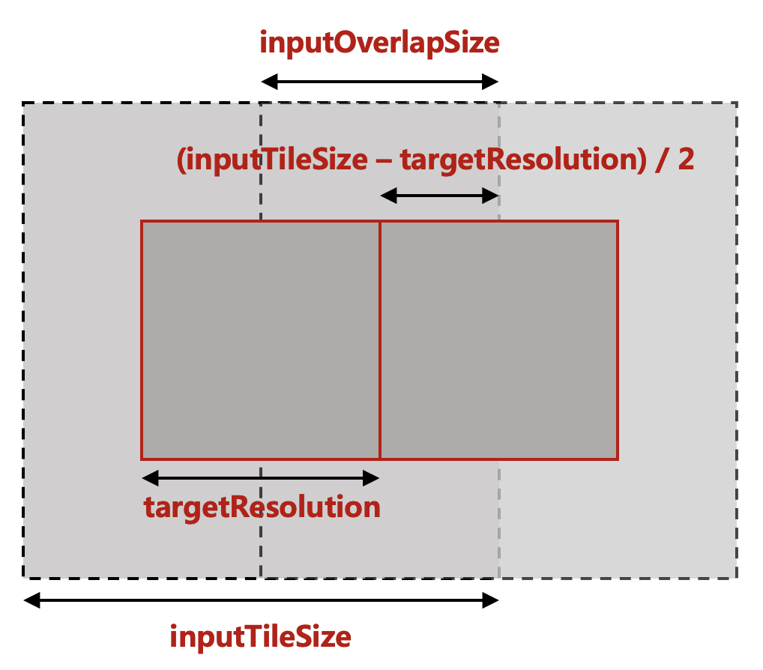
Workflow for global 3D building information mapping
Google Earth Engine
Sentinel-1/2 image
SRTM data
Google Earth Engine
High Resolution Settlement Layer
region
selection
Note: The HRSL dataset includes the information of human population at a resolution of 30 m.
image patching
3.2 Local machine
saved Tensorflow models
3.1 Google Cloud Storage
saved Tensorflow models
model loading
Compute Engine
Tensorflow model instances
Compute Engine
Predicted building height and footprint images
Google Cloud Storage
patched TFRecord datasets
dataset
loading
model
predicting
Note: The `Compute Engine` here can be a Google Virtual Machine, a Google Colab notebook or a local machine.
Prediction with pretrained CNN models from SHAFTS on Google Cloud Infrastructures

Slide 3
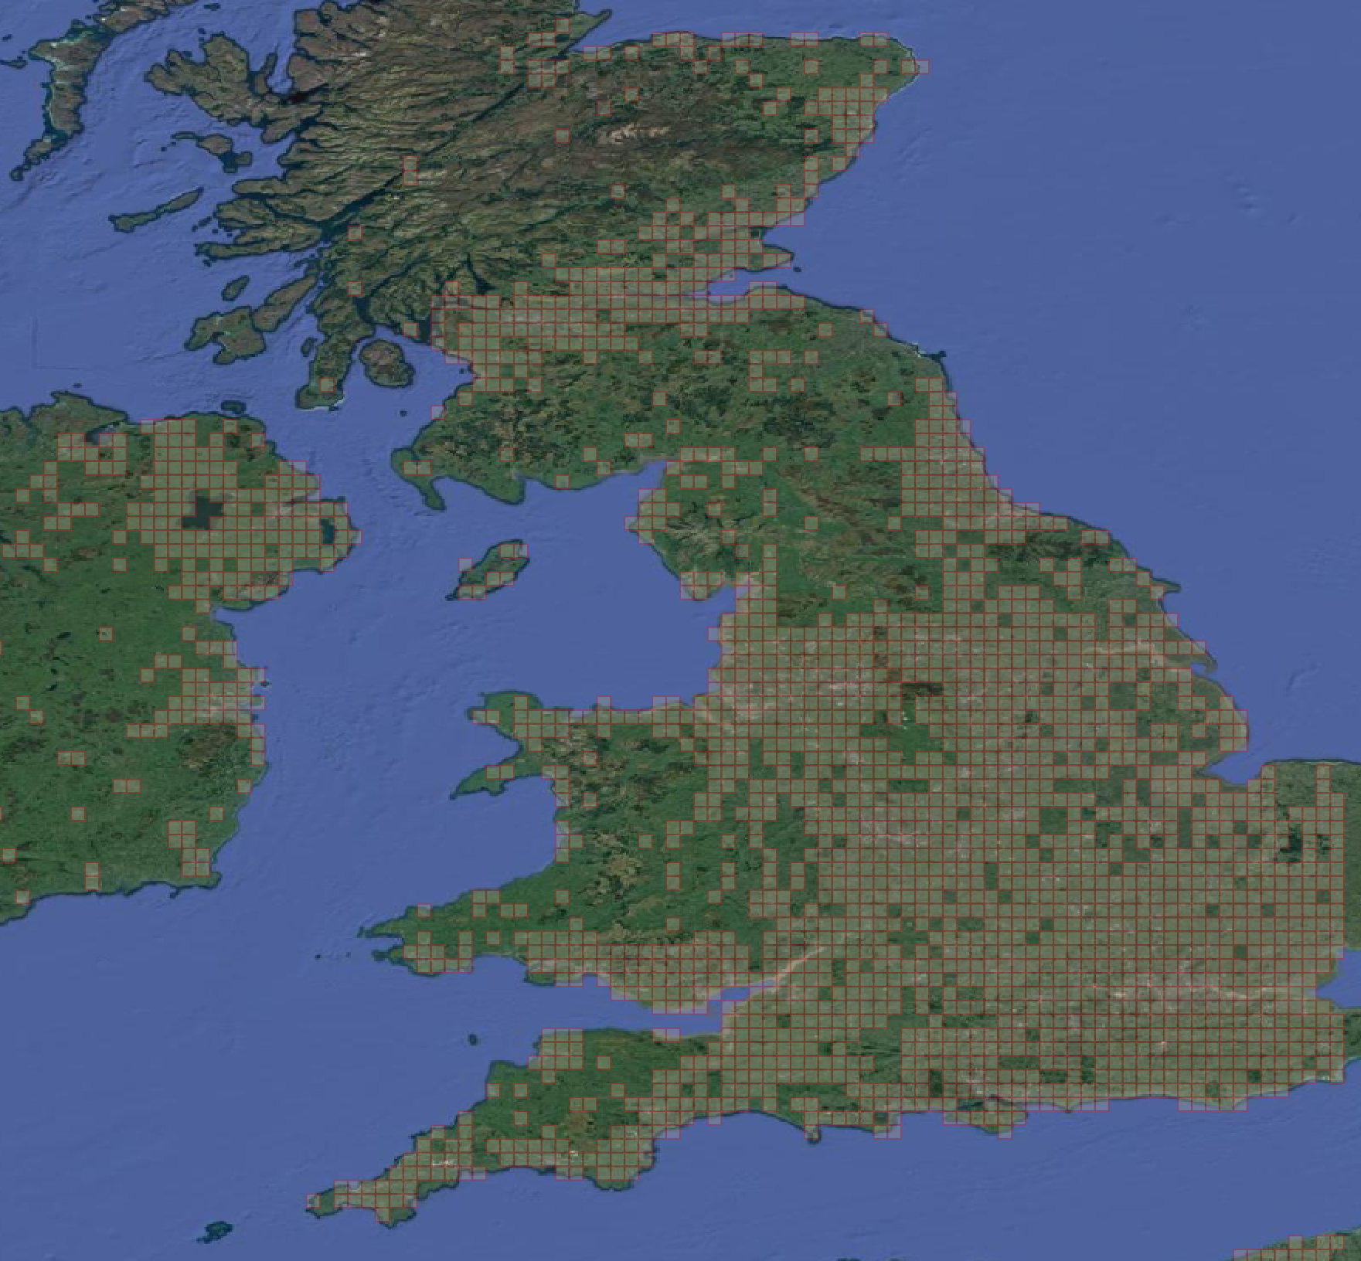
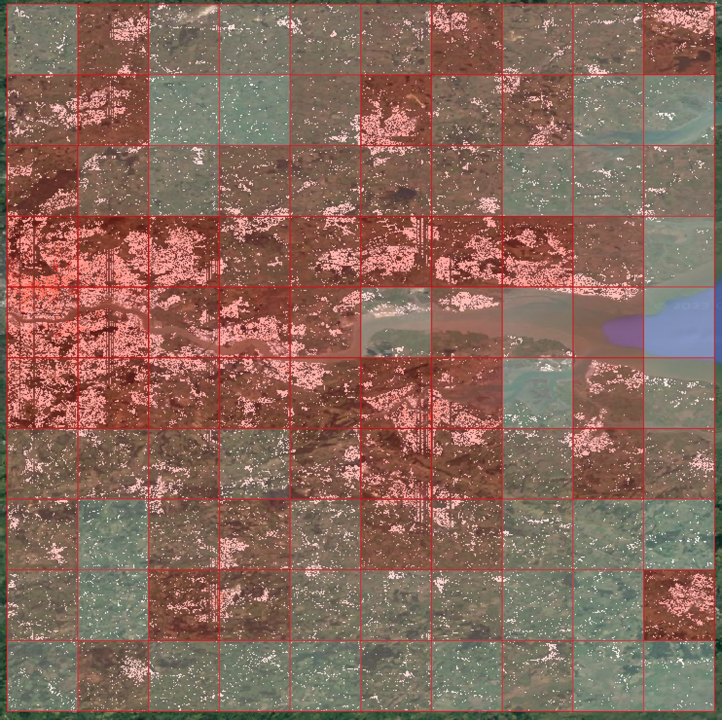

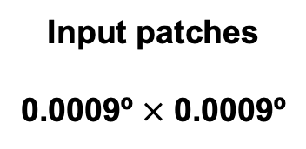


Workflow for global 3D building information mapping
Input patches
0.0009º $×$ 0.0009º
SHATFS
prediction
100 $×$ 100 = 10000 patches for every sample area
Sample areas
0.09º $×$ 0.09º
Regions of Interests
0.9º $×$ 0.9º
Prediction with pretrained CNN models from SHAFTS on Google Cloud Infrastructures

Slide 4
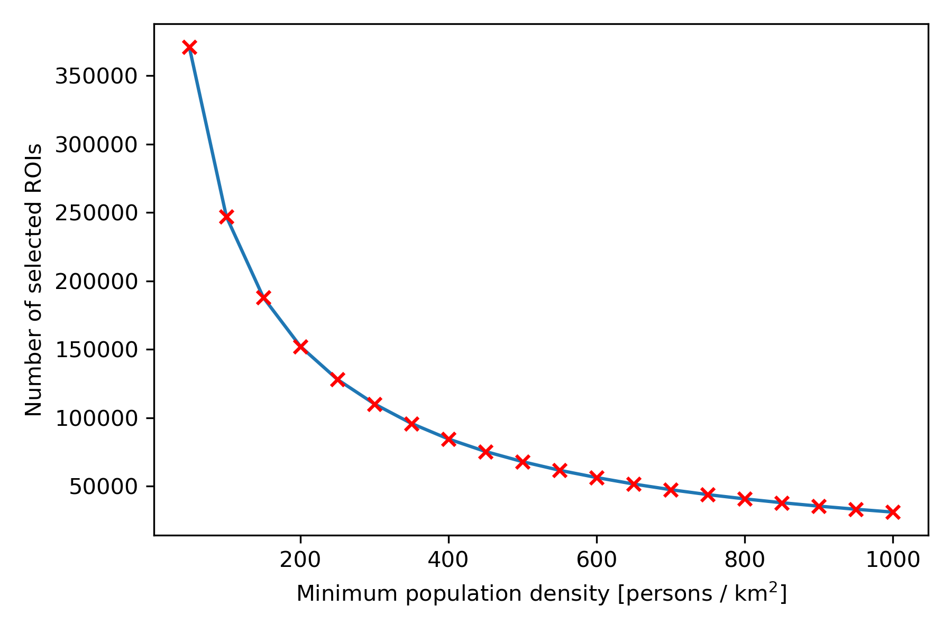
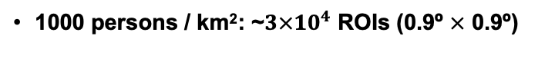

Workflow for global 3D building information mapping
Test the time of CNN inference on UCL’s Research Computing Service
If we want to finish our task in one week, then we need:
~ 20 s / ROI
300
300 persons / km²: ~${10}^{5}$ ROIs (0.9º $×$ 0.9º)
1000 persons / km²: ~${3×10}^{4}$ ROIs (0.9º $×$ 0.9º)
Reference population data: https://sedac.ciesin.columbia.edu/data/set/gpw-v4-population-density-adjusted-to-2015-unwpp-country-totals-rev11
Prediction with pretrained CNN models from SHAFTS on Google Cloud Infrastructures

Slide 5
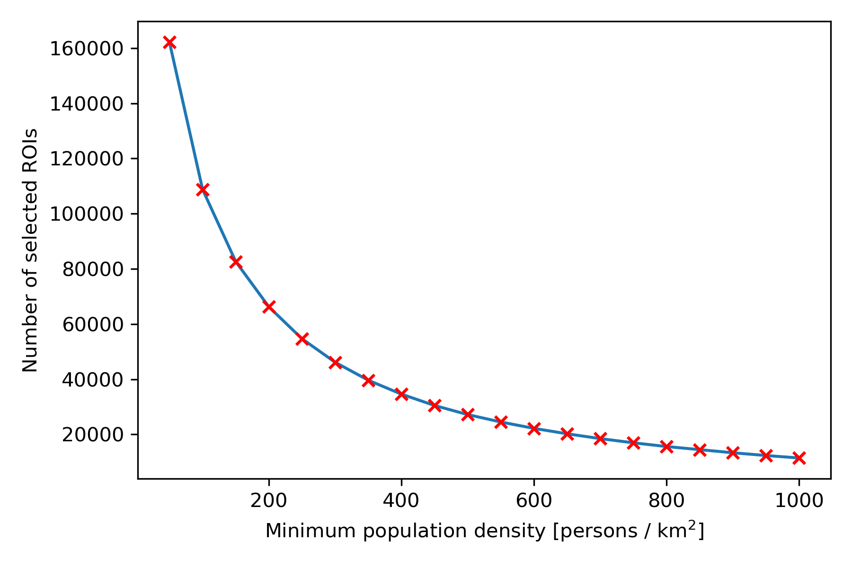


Workflow for global 3D building information mapping
Test the time of CNN inference on UCL’s Research Computing Service
If we want to finish our task in one week, then we need:
~ 60 s / ROI
300
300 persons / km²: ~${5×10}^{4}$ ROIs (0.9º $×$ 0.9º)
1000 persons / km²: ~${1×10}^{4}$ ROIs (0.9º $×$ 0.9º)
Reference population data: https://ciesin.columbia.edu/data/hrsl/#data
Prediction with pretrained CNN models from SHAFTS on Google Cloud Infrastructures

Slide 6

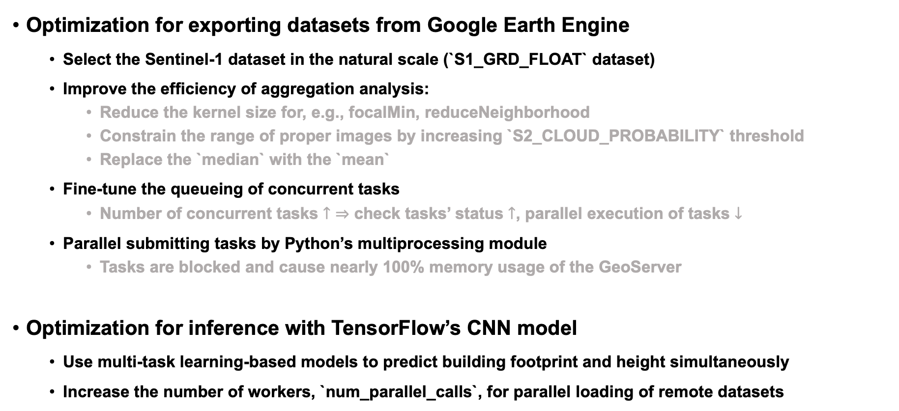
Code Optimization
Optimization for exporting datasets from Google Earth Engine
Select the Sentinel-1 dataset in the natural scale (`S1_GRD_FLOAT` dataset)
Improve the efficiency of aggregation analysis:
Reduce the kernel size for, e.g., focalMin, reduceNeighborhood
Constrain the range of proper images by increasing `S2_CLOUD_PROBABILITY` threshold
Replace the `median` with the `mean`
Fine-tune the queueing of concurrent tasks
Number of concurrent tasks $↑$ $⇒$ check tasks’ status $↑$, parallel execution of tasks $↓$
Parallel submitting tasks by Python’s multiprocessing module
Tasks are blocked and cause nearly 100% memory usage of the GeoServer
Optimization for inference with TensorFlow’s CNN model
Use multi-task learning-based models to predict building footprint and height simultaneously
Increase the number of workers, `num_parallel_calls`, for parallel loading of remote datasets
Prediction with pretrained CNN models from SHAFTS on Google Cloud Infrastructures

Slide 7
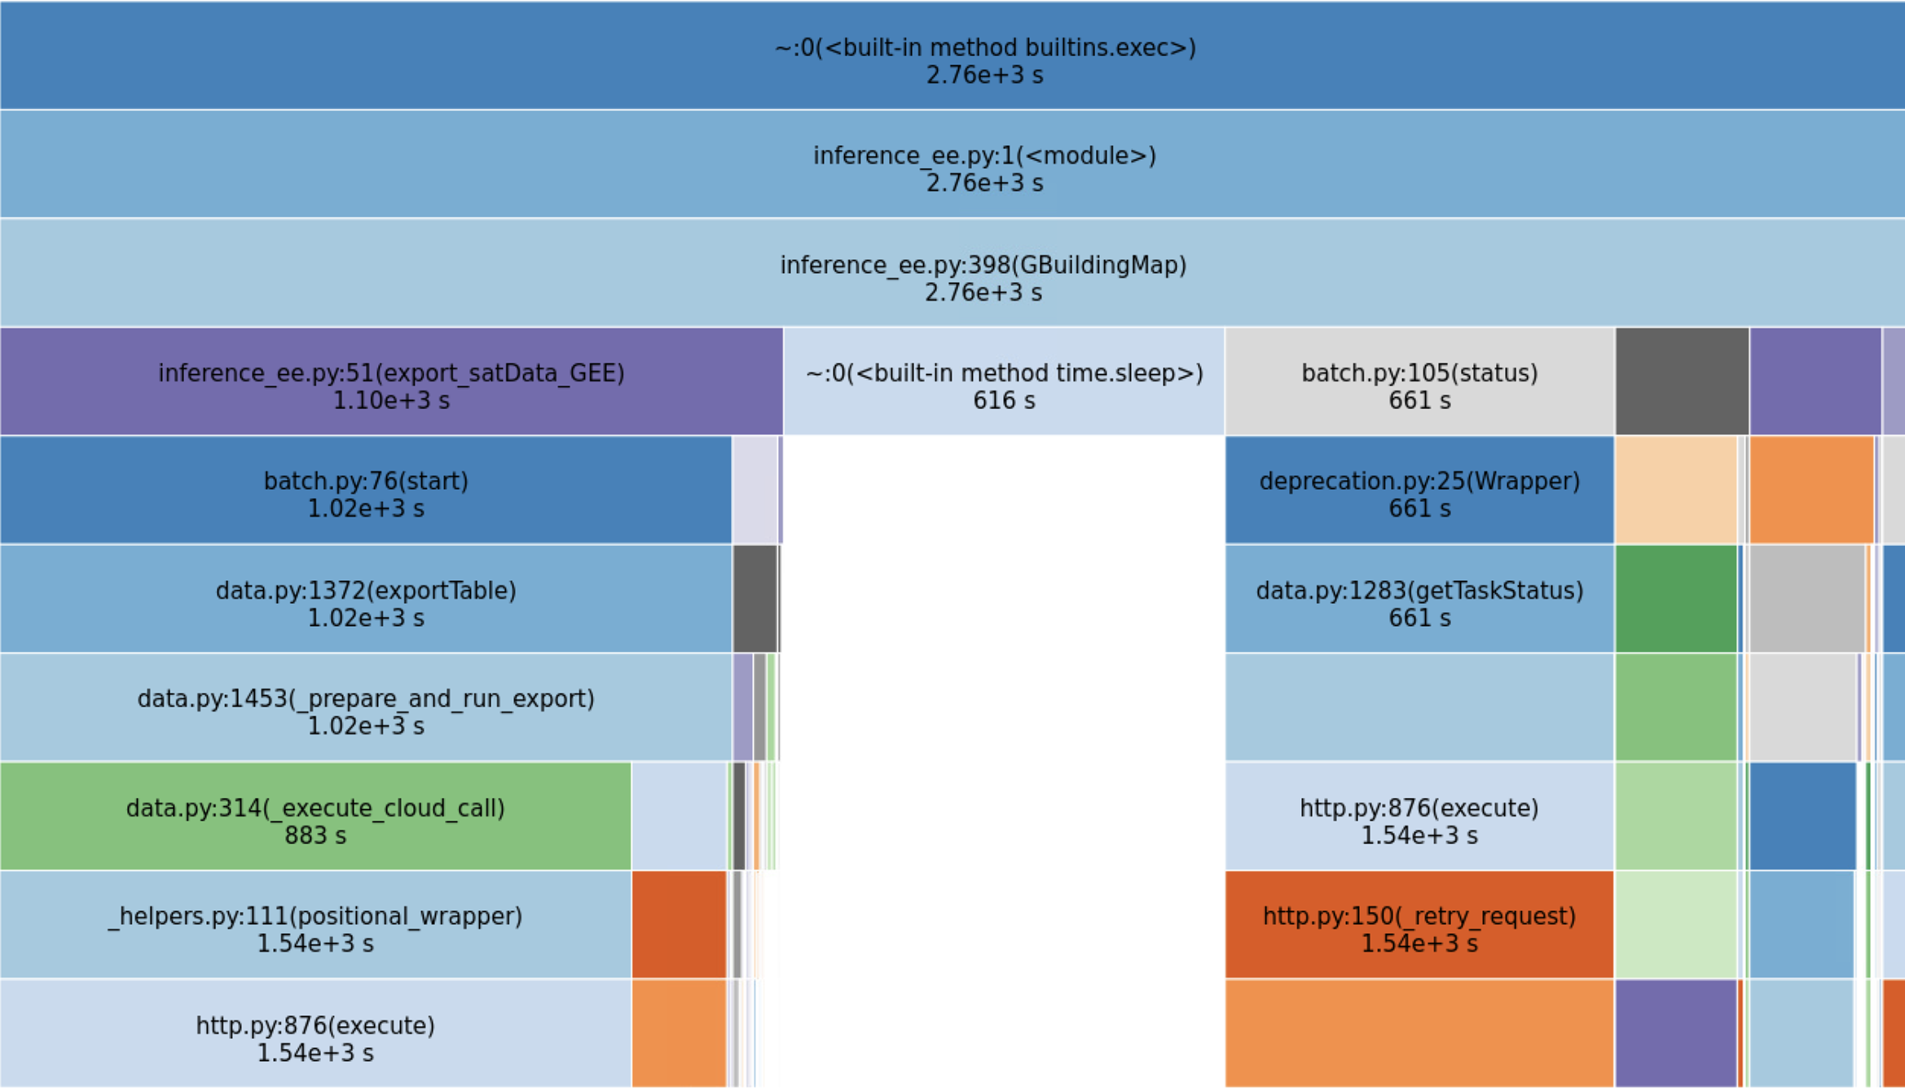
Code Optimization
Prediction with pretrained CNN models from SHAFTS on Google Cloud Infrastructures

Slide 8
inputOverlapSize
(inputTileSize – targetResolution) / 2
targetResolution
inputTileSize
Resources

